Slide 1
SYRIATEL CUSTOMER CHURN PREDICTION
Phase 3 project
2024
Forecasting Client Turnover

Slide 2
Overview
The telecommunication industry is a key player in our daily lives, particularly in media transmission, experiencing continuous growth.
Operators in this sector face the ongoing challenge of staying competitive amidst rapid advancements.
Retaining existing customers is paramount, as customer churn, the rate at which subscribers switch to competitors, poses a significant threat.
Customer churn prediction involves employing data mining techniques to analyze customer data and anticipate churn.

Slide 3
Project Workflow
Mercury
Sun
Venus
Mars
Saturn
The Sun is the star at the center
Venus is the second planet from the Sun
Despite being red, Mars is actually cold
Saturn is a gas giant and has rings
Jupiter
Jupiter is a gas giant and it’s big

Slide 4
Business Understanding
Business Problem
Customer churn, the rate at which customers terminate services with a company, presents a significant challenge for telecom companies like SyriaTel.
It impacts revenue, marketing expenses, and brand perception, directly affecting financial stability and market standing.
Objectives
Develop a precise machine learning model for forecasting customer churn, leveraging pertinent dataset features and classification training to identify customers prone to churn.

Slide 5
Data Understanding
The data for this project comes from the "Churn in Telecom" Kaggle dataset and focuses on customer activity and churn, which is when a customer cancels their service.
This data will be used to build models that help SyriaTel reduce financial losses from customer churn.
The dataset includes 3,333 customer records with 21 features about each customer, including demographics, service plans, call metrics, and a key variable indicating whether they churned (cancelled).
The target column, "churn," is a boolean column. In this context, "True" indicates that the customer churned, while "False" signifies that the customer did not churn. Thus, this situation presents a binary classification problem.

Slide 6
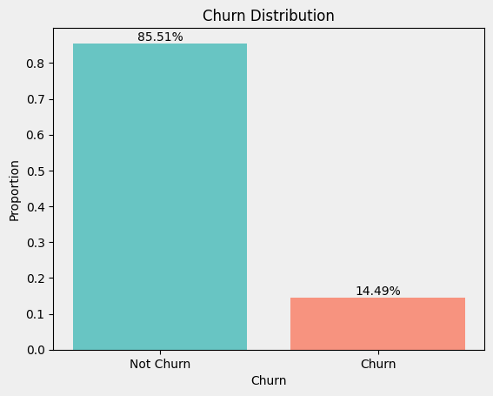
Data Analysis
Univariate EDA
Total customer count:
3,333
Count of churned customers:
483
Churn rate:
14.5%

Slide 7
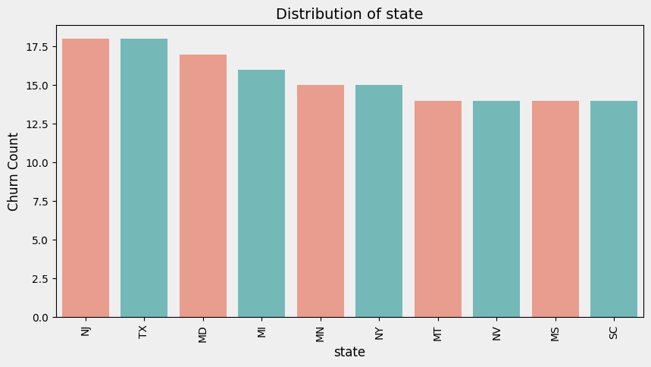
Data Analysis
Bivariate Analysis
The majority of churned customers are from New Jersey, Texas, Maryland, Miami, and New York.

Slide 8
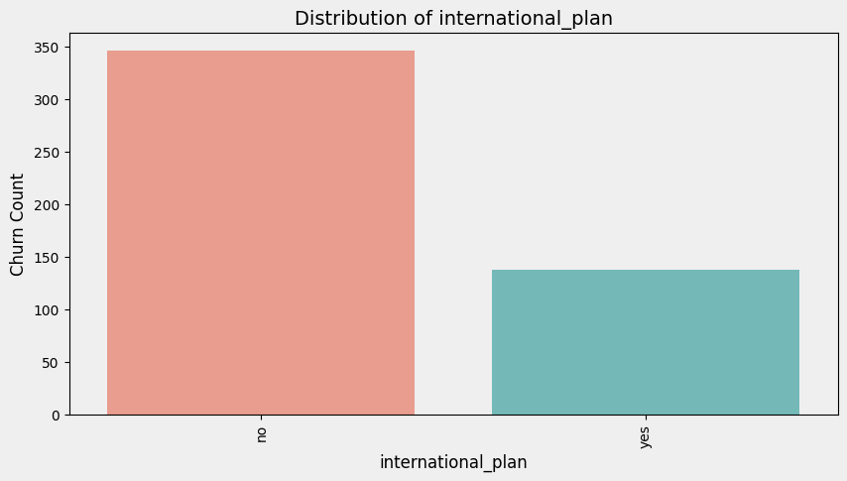
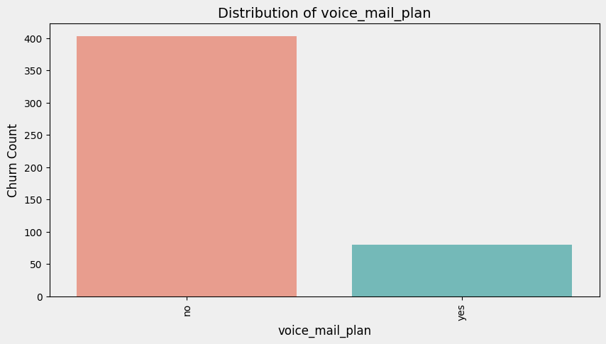
Data Analysis
Bivariate Analysis
Subscribers to the international plan exhibit a notably higher likelihood of churning.
For the voice mail plan, there is a reduced likelihood of churning compared to the general churn rate.

Slide 9
Modeling
The data posed a binary classification challenge, where various classification models were applied, and the one demonstrating the highest accuracy was chosen.
The project employed classification models such as:
Logistic Regression.
Decision Tree.
Random Forest,.
XG Boost.
XGBoost was choosen as it proved a better model due to its higer accuracy.

Slide 10
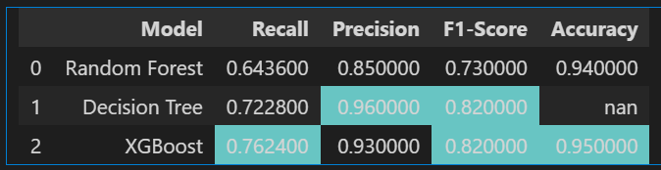
Model Evaluation
XGBoost achieved the highest overall performance with a recall of 0.76, precision of 0.93, F1-score of 0.82, and accuracy of 0.95.
Random Forest follows closely with a recall of 0.64, precision of 0.85, F1-score of 0.73, and accuracy of 0.94.
Decision Tree shows improvement over Logistic Regression but falls short of Random Forest and XGBoost.
Logistic Regression performance details are missing from this section but were presumably reported earlier.

Slide 11
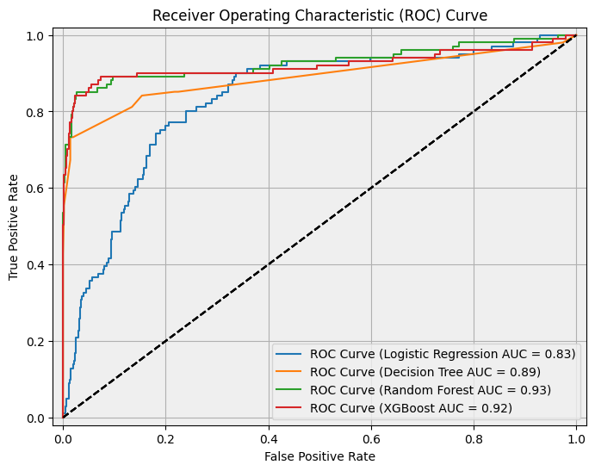
Model Evaluation
ROC curve interpretation
Logistic Regression: AUC = 0.83
Decision Tree: AUC = 0.89
Random Forest: AUC = 0.93
XGBoost: AUC = 0.92
The Random Forest model has the highest AUC value, indicating that it has the best performance among the four models according to this metric.

Slide 12
Conclusion
This analysis successfully achieved the objectives of building a machine learning model for customer churn prediction and utilizing it to estimate churn probability.
Two models, Random Forest and XGBoost, were compared for their effectiveness in predicting churn.
Both models demonstrated strong performance, with Random Forest showcasing a robust overall performance and XGBoost achieving a high recall score.
Discussion: SyriaTel should prioritize the Random Forest Classifier as the primary model for predicting customer churn due to its superior overall performance and ability to accurately identify potential churners.

Slide 13
Recommendation
The analysis identified key factors significantly impacting customer churn prediction (Feature Importance):
Call minutes and charges (daytime, evening, international)
Customer service calls
Usage of value-added services (voicemail plan)
Based on these insights, SyriaTel should implement strategic customer retention efforts that address these factors:
Personalized offers and discounts: Target customers based on their usage patterns (e.g., high day charges) with relevant incentives.
Reduce customer service calls: Invest in strategies like interactive voice response (IVR) systems to improve customer experience and decrease churn associated with frequent calls.
Promote value-added services: Highlight the benefits of services like voicemail plans and incentivize customer adoption.

